Slide 1

Prabhu Thangavel aka Vijay
Experienced IT professional with over 10+ years of industry expertise.

Slide 2
About Edureka
Edureka is a leading online learning ecosystem.
It is one of the best platform for both live and self-paced sessions for learners with 24/7 support system.
Primary objective of edureka is making learning accessible to everyone.

Slide 3
Guidelines
Check your internet connectivity to avoid any network issues(www.speedtest.net)
By default you will be on mute to avoid any background noise, to speak unmute yourself and let us know who is talking.
Feel free to use Chat to interact with me at any point during class.
In addition to the main session, we will also allocate dedicated time at the end of each session to address any questions or concerns you may have.
This time is specifically reserved for discussing and clarifying any doubts that may have arisen during the session.
Your understanding and engagement are important to us, and we want to ensure that you have the opportunity to get the most out of our online teaching experience. Therefore, please feel free to bring up any queries or uncertainties you may have, and we will make sure to address them to the best of our ability.

Slide 4
Ground Rules
Unity in diversity : We’re a heterogeneous batch with varying experience levels
Re-energize yourself during “Hourly breaks!”
Key to success: Regularity to live sessions and assignment completion on time
Please share feedback after each class which can help me to enhance your learning experience

Slide 5
Learning Management System (LMS)
Make Sure everyone has access to LMS (www.edureka.co)
This is the platform where you can track your complete training progress, session recordings support from technical team etc..

Slide 6
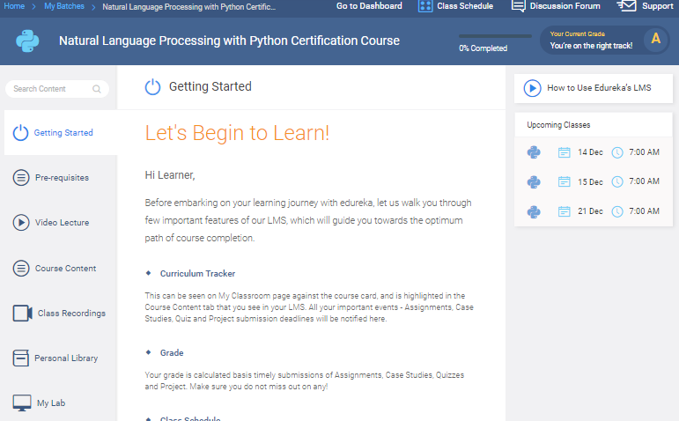

Class Schedule: “Join Now” to attend. Be regular and punctual.
24X7 Support System available
for Tech/Non-Tech Support
Completion and Grade Tracker: Monitors progress, Aim for Grade “A”
Strengthen basics with “Pre-requisites” before every class
I can revisit “How to use LMS” video
Go through “recorded lectures” before every class
All course materials are available here
All class recordings are available within 04 hours
Learners can store course related documents here
Based on the course: Lab/VM is made available
Notes:
ONLY FOR REFERENCE - Please note all features are not available for all the courses

Slide 7
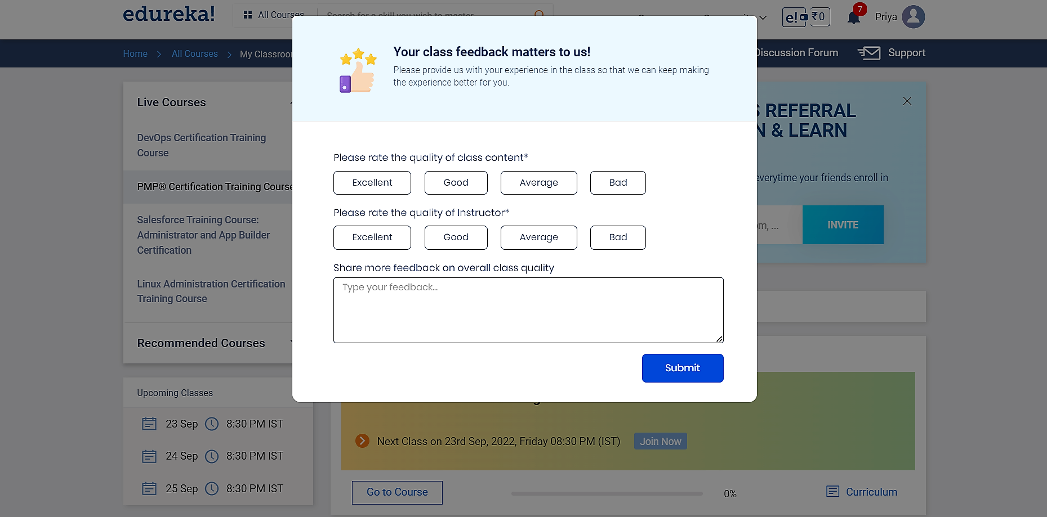
Survey Form Pop Up Post Session Completion

Slide 8
Questions
Before we begin, I would like to check if you have any questions or if there is anything you would like to clarify.
I want to ensure that you have all the information you need before we proceed. If everything is sorted and you are ready, let's dive right into the session and make the most of our time together.

